Slide 1


MANOHARBHAI PATEL INSTITUTE OF ENGINEERING AND TECHNOLOGY SHAHAPUR , BHANDARA
Seminar On
ONLINE MUSIC SHARING PLATFORM
Presented By
Miss. Pranjali Ganvir
Miss. Prachi Dharmik
Miss. Amisha Ghatole
Miss. Akanksha Bangre
Miss. Isha Telmasre
Under The Guidance Of
Prof. Omkar Dudhbure

Slide 2
CONTENT
Introduction
Objective
Data flow diagram
Technology Used
Methodology
Snapshots
Conclusion
Advantages
Reference

Slide 3
INTRODUCTION
This project is called Ultimate Music Sharing Platform
The project the ultimate music sharing platform using php and mysql is a complete ultimate music sharing platform script which you can use to create your own music sharing/ store website.
It includes many features which makes it unique for your music sharing website project. It has a high quality design and easy to modify.

Slide 4
OBJECTIVE
The main objective of the online music portal is to manage the details of :
music, performer, album, customer, album type.
It manages all the information about music, track, album type, music.
The primary purpose of spotify is to make it easy for consumer to access and share digital content with each other

Slide 5
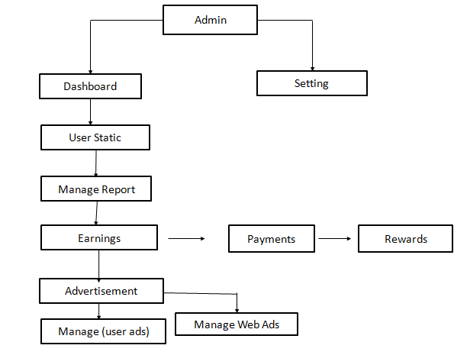
DATAFLOW DIAGRAM

Slide 6
User Login
Song Upload
Import
Upload single Song
Upload an album
URL
Select file to upload
Album Title
Publish
Image
Upload Folder
Publish

Slide 7
TECHNOLOGY USED
Front End
Coding language : Html ,Css ,Javascript
Back End
PHP
Database : MySQL
Mvc & Spring

Slide 8
SOFTWARE &HARDWARE REQUIREMENT
Hardware Requirement
Ram : 2GB
Any -Dual Core Processer
Hard Disk : 50 GB
Software
Xammp
Operatingsystem : Windows 7 and Above

Slide 9
METHODOLOGY
Modules descriptions
ADMIN MODULE
The admin module contain the complete details about users and view the details/ information .there are some modules like login, user view, etc… the login is use to create a login and sign in to the login. User view contain the user details.
LOGIN
USER VIEW
USER MODULES
Contain the every user details who register as the user. The people who want to see the songs and the upload / imports the songs of the music sharing platform.
REGISTER
LOGIN
VIEW SONGS

Slide 10
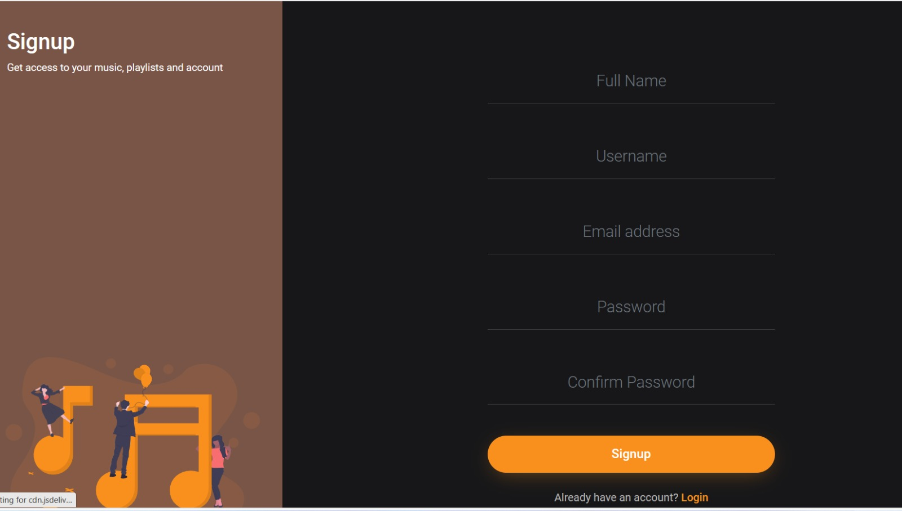
SNAPSHOT
Register Page:
The first thing you will need to do is create a account on music sharing platform. You can do this by going to the website clicking “Sign Up” once you have created an account.

Slide 11
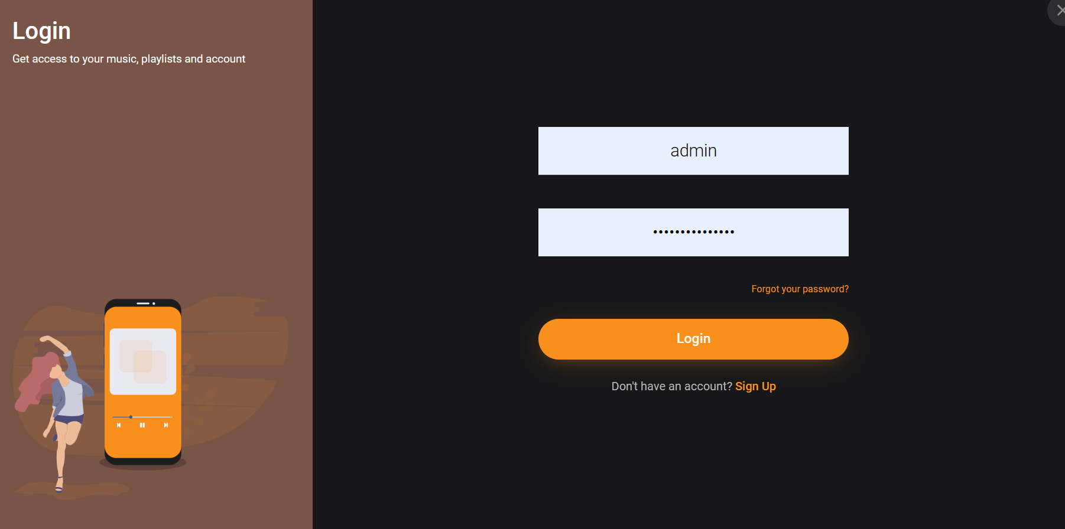
Login Page:
Click your name at the top-right, and then select account from the drop-down list that appears,

Slide 12
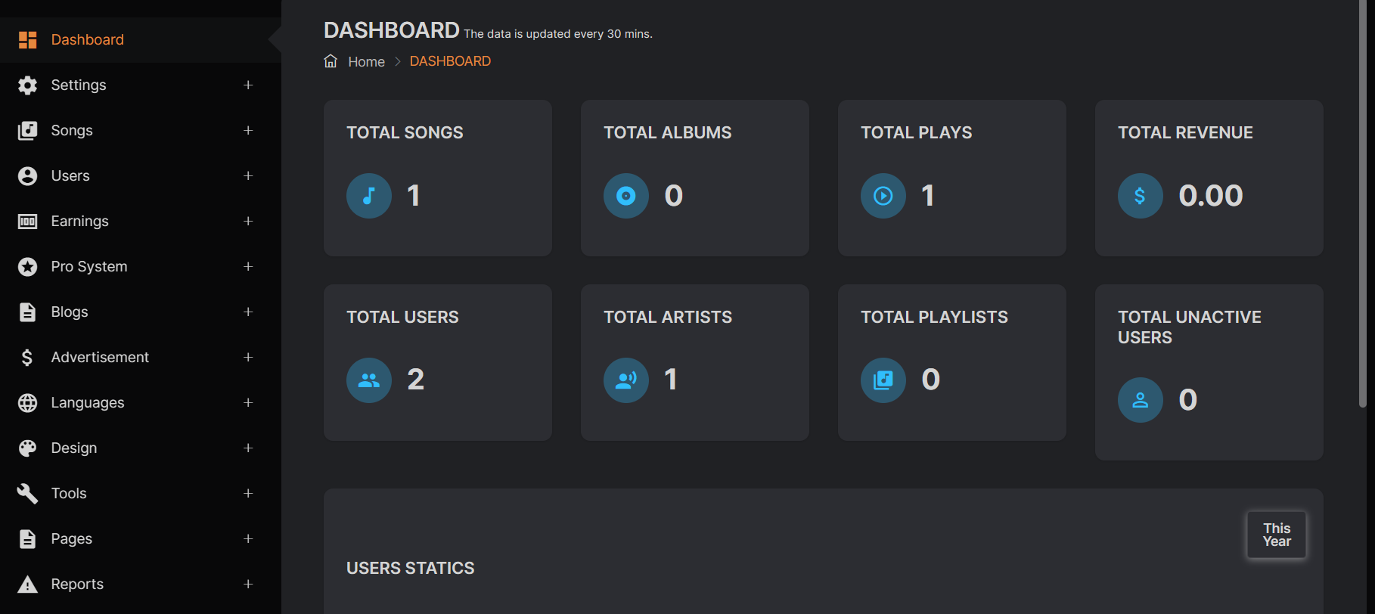
Admin Panel:
The admin contain the complete details about user and view the user information. There are some modules likes total songs , total users, and total playlist etc…..send the message to users .

Slide 13
CONCLUSION
The internet has much more power than the music industry today.
Streaming and online music services have taken.
over digital downloads and physical media
As a result people have easy access to a wider range of music and are able to gain a following online via social media when sharing their own music challenging the traditional notion of record eals

Slide 14
ADVANTAGE
They help you to access a vast variety of music.
It helps the artists gain more popularity.
Artists can authorize their content
They prevent illegal music downloads.

Slide 15
REFERENCE
K. Mohamed and D. Wijeskera, "A lightweight framework for web services implementations on mobile devices", 2012 IEEE First International Conference on Mobile Services, 2012.
Brabec, Jeff, Brabec, Todd, 2018. Music Money and Success', Schirmer Trade Books, 8" Ed.
Passman, Donald S., 2019, 'All You Need To Know About the Music Business'. Simon & Schuster Publication, 10th Ed.
4. Hesmondhalgh, David, Jones, Ellis, & Rauh, Andreas. (2019). SoundCloud and Bandcamp as alternative music platforms. Social Media + Society, 5(4), 205630511988342. https://doi.org/ 10.1177/2056305119883429 IFPI. (2021). Global music report: Data and analysis for 2020
Jones, E. (2019). DIY and popular music: Mapping an ambivalent relationship across three historical case studies. Popular Music and Society, 44(1), 60–78. https://doi.org/10.1080/03007766. 2019.1671112
Caplan, R., & Gillespie, T. (2020). Tiered governance and demonetization: The shifting terms of labor and compensation in the platform economy. Social Media + Society, 6(2), 205630512093663. https://doi.org/10.1177/2056305120 936636 7. Cooke, C. (2021). Tencent share price dips as Chinese regulator confirms exclusivity deal ban. Retrieved July 27, 2021, from https://completemusicupdate.com/a rticle/tencent-share-pricedips-aschinese-regulator-confirmsexclusivity-deal-ban/
Ingham, T. (2019). DIY artists will earn more than $1 billion this year. No wonder the major labels want their business. Retrieved December .12, 2020, from https://www.rollingstone.com/pro/ features/diy-artists-will-earn-morethan-1-billion-this-year-no-wonderthe-major-labelswant-theirbusiness-830863/s
8. Drott, E. (2018). Music as a technology of surveillance. Journal of the Society for American Music, 12(3), 233–267. https://doi.org/10.1017/S17521963 18000196

Slide 16
Thank you
Thank You

